Slide 1
Regulatory Compliance Mapping Tool (RCMT)
Status Brief
Presented to: AOV Leadership
By: Aeronautical Information Standards Branch, AOV-110
Date: September 20, 2023

Slide 2



Sprint 52
Ended: 08/04/23
Sprint 53
Ended: 08/25/23
Sprint 54
Ended: 09/14/23
What’s New in RCMT UI this Sprint?
Text and Concept searching in PDF View
# of documents in RCMT Library: 612
What’s New in RCMT UI this Sprint?
User Experience improvements in PDF View and Doc View
# of documents in RCMT Library: 676
What’s New in RCMT UI this Sprint?
5000+ concepts added to the RCMT Ontology for a total of over 26,000 concepts
# of documents in RCMT Library: 746 (as of 9/19)
Sprint 52 Major Accomplishments
Ongoing improvements to Concept Research and Collections functionality including bug fixes
Continued improvements to direct data ingest capability
Began setting up Cypress automated test cases for Concept Research
Submitted quarterly security scan requests
Delivered final Ontology 1.2 to Lymba
Processing linked terms for Ontology 1.3 received from AOV PM
Mining terms for Ontology 1.4 workbook
Deployed 72 new documents to RCMT including 3 superseding documents
Sprint 53 Major Accomplishments
Implemented initial OpenSearch functionality; additional testing in progress
Improvements and fixes in Collections feature
Delivered Ontology 1.3 to Lymba and evaluated NLP results based on Ontology 1.3
Server and Database security scan findings resolved
Deployed 64 new documents to RCMT including:
2 superseding documents
Remaining AVS Orders
Remaining ICAO Annexes and Docs
Sprint 54 Major Accomplishments
Concept Profiler now displays definition sources
Collection deletion confirmation now available
NLP Cycle 1.3 initiated (incl. Onto 1.3)
Ontology 1.4 term extraction completed
iCatalyst NLP Engine development in progress
Completed quarterly update to maintain currency of components and packages used to build RCMT User Interfaces
Deployed 70 new documents to RCMT including:
2 superseding documents
Several additional Tech Ops orders

Slide 3
RCMT Highlights
RCMT Software Development
High Volume Document Ingestion with focus on USOAP Audit support
Goal: Remaining FAA Orders
Status: 746 documents as of 9/19 ( up from 612 as of 8/9 – a 22% increase)
Includes all AVS Orders
Includes all ICAO Annexes & Procedures for Air Navigation Services (PANS)
Includes 14 CFR Parts 1-199
200+ ATO Orders
The RCMT Library has more than tripled in size since the April 3rd launch (up from 225 – 232% increase)
User Interface Testing
Enhanced coverage for automated User Interface testing through Cypress Testing Suite
Section 508 Compliance Testing is in progress
Ontology 1.3 and 1.4:
Ontology 1.3 NLPed and deployed to RCMT. Includes 26,235 concepts (24% increase from Ontology 1.1)
Ontology 1.4 term mining currently in progress
Ongoing coordination with AIT Security Office
RCMT Security Characterization Framework Checklist submitted to and approved by AIT Security Office
All findings from Server and Database security scans resolved.

Slide 4
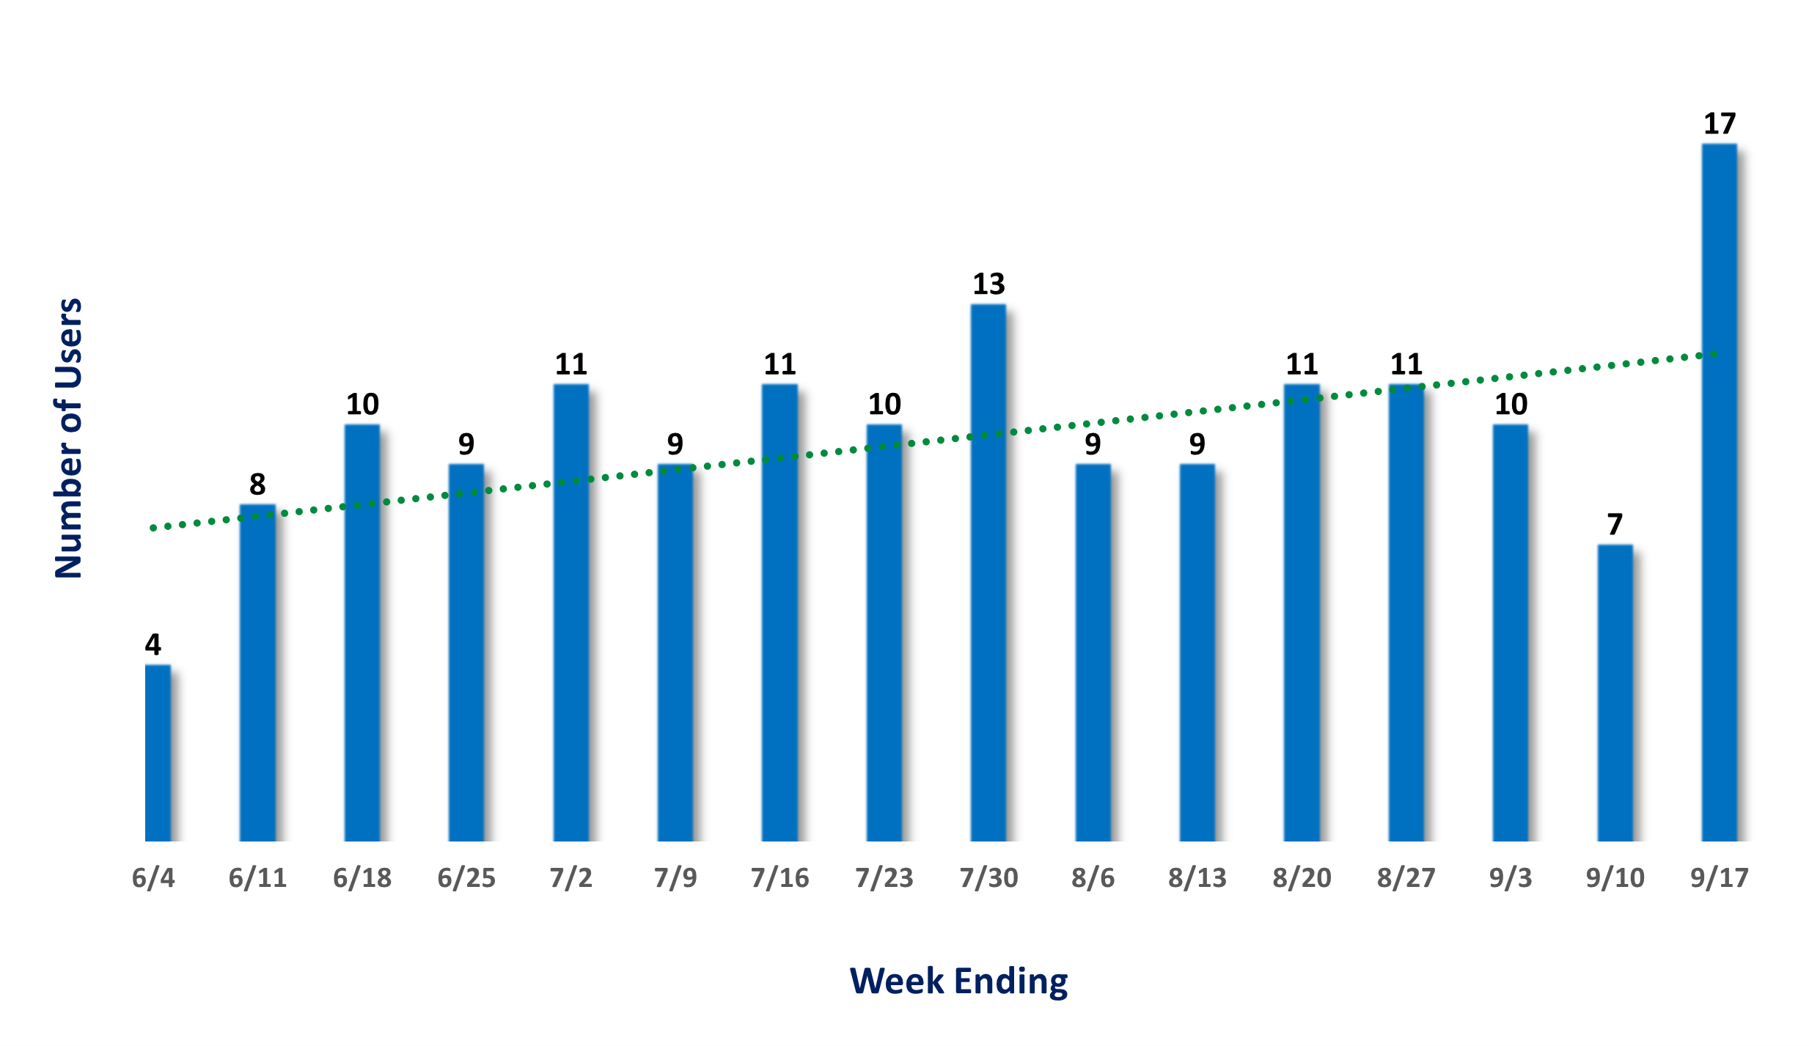
RCMT Usage by Week
Notes:
Week Ending 06/04: 4 users (includes Memorial Day holiday)
Week Ending 06/11: 8 users (June bulletin distributed)
Week Ending 06/18: 10 users
Week Ending 06/25: 9 users (includes Juneteenth holiday)
Week Ending 07/02: 11 users (RCMT Summer Series briefing on 6/27)
Week Ending 07/09: 9 users (includes July 4th holiday; July bulletin distributed)
Week Ending 07/16: 11 users
Week Ending 07/23: 10 users
Week Ending 07/30: 13 users
Week Ending 08/06: 9 users (August bulletin distributed)
Week Ending 08/13: 9 users
Week Ending 08/20: 11 users
Week Ending 08/27: 11 users
Week Ending 09/03: 10 users
Week Ending 09/10: 7 users (includes Sep 4th holiday)
Week Ending 09/17: 17 users

Slide 5
RCMT – NLP Challenge and Proposed Solution
Lymba | Proposed Solution
Problem/Challenge: Evaluation of Lymba’s NLP results delivered on 6/15 reflect several issues that prevented the ability to utilize the output for a data push to RCMT. | iCatalyst Ontologist is developing an NLP solution to replace Lymba’s current tool. iCatalyst and AOV will test the output for accuracy and completeness. iCatalyst and AOV will compare the tool performance to Lymba’s in order to determine which can produce reliable and accurate results as expected. Review of results to be determined.
Interim Mitigation #1: AOV Project Lead and iCatalyst coordinated with Lymba to develop detailed processes and procedures to better identify breakpoints/causal factors driving current issues.
Interim Mitigation #2 (Complete): Lymba used the previous NLP iteration that was utilized for the April 2023 release of RCMT. The concepts established from Ontology V 1.2 and V 1.3 and documents ingested were NLPed for NLP cycle 1.3.

Slide 6
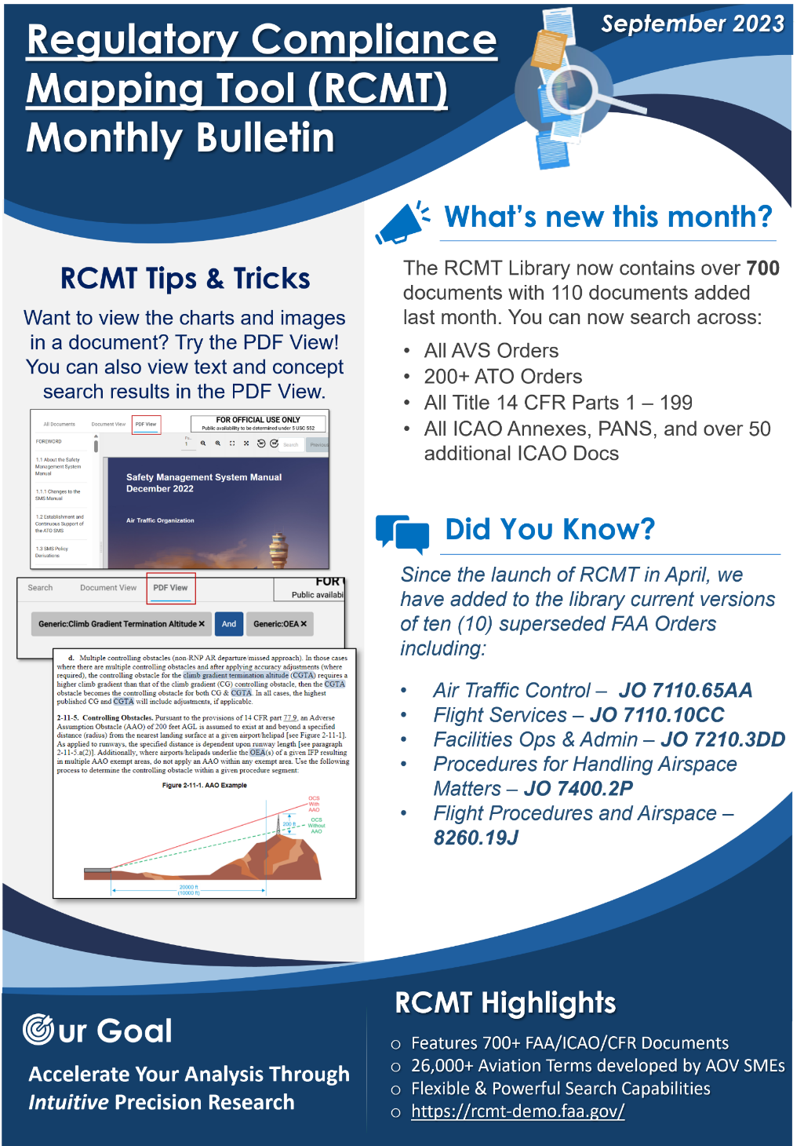
RCMT Monthly Bulletin (September)
Monthly Bulletin:
Release monthly communications to the RCMT user population that incorporates various elements such as:
What’s new this month?
RCMT Tips & Tricks
A rotating feature section that may include testimonials or a “Did You Know?”
Goal:
Spark curiosity and maintain interest in the RCMT application
Showcase the progression of the tool as it evolves, and development continues

Slide 7
RCMT Status Summary
PROJECT SCOPE / OBJECTIVES
PROJECT TEAM & FUNDING
Deploy the Regulatory Compliance Mapping Tool (RCMT), a web-based tool that uses cutting-edge semantic technology to transform FAA and ICAO documents into an intuitive searchable knowledgebase. Allows more efficient and effective knowledge text extraction and analysis, further fueling risk-based, data-driven decision-making. Users can search across information more effectively and efficiently (reducing research time from days or weeks to hours), use meaning and context to discover related content. Overall intent is to improve the depth, timeliness and efficiency of research.
Aeronautical Information Standards Branch, AOV-110
Program Manager: Melissa Wishy, AOV-110
AOV Project Lead: Aishat Nauzo, AOV-110
AOV Support: Scott Luka, AOV-110
Contract Support: iCatalyst, Inc.
Funded by AVS-AQS
COMPLETED ACTIVITIES
CURRENT ACTIVITIES
RCMT User Support & Outreach: Distributed August bulletin
User Interface: 1) User experience improvements in Concept Research; 2) Collections bug fixes; 3) Initial OpenSearch implementation (not rolled out to users yet)
User Interface Testing: Implemented automate testing framework, Cypress Suite. Developed automated tests for Concept Profiler and Concept Research
Ontology: 1) Ontology 1.3 finalized and delivered to Lymba; 2) Ontology 1.4 term extraction (80% complete)
NLP Cycle 1.3: K-Extractor installed for NLP Cycle 1.3; Lymba process documentation complete
Security: Resolved all findings related to Server and Database security scans
Document Ingestion: 110 new documents added to FAA Staging/Demo since 8/9. Complete doc sets in RCMT: AVS orders, API Orders, Title 14 CFR Parts 1-199; All ICAO Annexes and PANS; Over 200 ATO Orders. Total RCMT document count in FAA Staging/Demo as of 9/19: 746
RCMT User Support and Outreach: Continue post-deployment user support, develop RCMT Aug bulletin, present RCMT update to AOV-30 ahead of US/ Japan/ South Korea ICAO Trilateral
User Interface: 1) Adding definition sources in Concept Profiler; 2) Updated PDF View Document Trees. 2) Enhancements to PDF view functionality. 3) Implement & Test Open Search. 3) Bug fixes and AOV feedback items
Ontology: 1) Ontology 1.3 deployment in RCMT User Interface. 2) Mining terms for Ontology 1.4 for linked terms development
NLP Cycle 1.3: As of 8/30 documents being NLP’ed with Ontology 1.3
Document Ingestion: Currently working on ingesting Tech Ops documents
iCatalyst NLP: Working on “beta” iCatalyst NLP solution to conduct initial comparison and evaluation with respect to Lymba’s NLP product, K-Extractor
Section 508: RCMT Application testing for Section 508 compliance in progress
Security: Supporting initial stages of Security Authorization process
PLANNED MILESTONES
PROJECT UPDATES & RISKS / DEPENDENCIES
High-Volume Document Ingestion (Ongoing): Prioritize superseding versions of existing documents in RCMT library, remaining ICAO Annexes (Complete), AVS Orders (Complete), 14 CFR Parts 1-199 (Complete), Remaining FAA Orders
Ontology Growth (Ongoing): Aviation Term mining from new documents added to RCMT
PDF Solution (Ongoing): Design and implementation of PDF solution – phased approach
508 Compliance Testing (Ongoing): Initial activities to support 508 Compliance Testing
NLP False Negatives & False Positives affect accuracy of Concept Search
Document time readiness is slow
AOV-110 user testing feedback is essential
Robust regression testing is essential
June 2023
July 2023
August 2023
September 2023
Concept Search results in PDF View
Doc Ingestion – FS Orders complete
Ontology 1.2 terms extracted
K-Extractor Ver 7.8.0 evaluation
Collections in PDF View (In progress)
Doc Ingestion – 14 CFR Parts 1-199 complete
Ontology 1.1 deployed to RCMT
Ontology 1.2 delivered to Lymba
Ontology 1.3 terms extracted
Section 508 Compliance Testing (In Progress)
Doc Ingestion – AVS Orders & ICAO Annexes complete
Ontology 1.3 delivered to Lymba
NLP Cycle 1.3 (In Progress)
Ontology 1.4 term extraction (In Progress)
Doc Ingestion – ATO Tech Ops Orders complete
Ontology 1.3 deployed to RCMT
Ontology 1.4 terms extracted
Section 508 Testing complete

